Slide 1
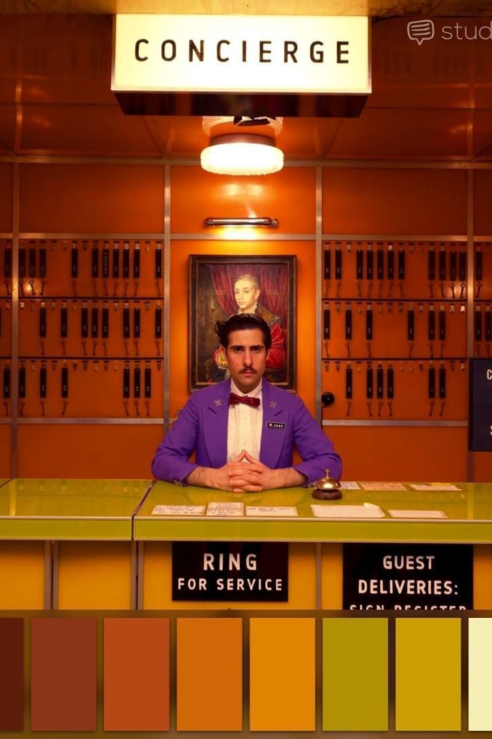

Optimizing Customer Retention for Hotel Lisbon
At Hotel Lisbon, how can we reduce the number of cancellations and no-shows? Through analysis of customer data and booking patterns, what actions can the hotel take?

Slide 2

The Initial Analysis: Key Findings
Demographic and Customer Information:
Booking Behavior and Preferences:
DistributionChannel: Booking distribution channel.
ID: Customer ID.
Nationality: Country of origin in ISO format.
MarketSegment: Current market segment of the customer.
Age: Customer's age at the last day of the extraction period.
SRHighFloor, SRLowFloor, SRAccessibleRoom, SRMediumFloor, SRBathtub, SRShower, SRCrib, SRKingSizeBed, SRTwinBed, SRNearElevator, SRAwayFromElevator, SRNoAlcoholInMiniBar, SRQuietRoom: Boolean indicators of various customer room preferences.
Booking and Revenue Information:
AverageLeadTime: Average days between booking and arrival.
LodgingRevenue: Total spent on lodging expenses (room, crib, etc.).
OtherRevenue: Total spent on other expenses (food, beverage, spa, etc.).
BookingsCanceled: Number of canceled bookings.
BookingsNoShowed: Number of no-show bookings.
BookingsCheckedIn: Number of bookings that resulted in a stay.
PersonsNights: Total persons/nights stayed at the hotel.
RoomNights: Total room/nights stayed at the hotel.
DaysSinceLastStay: Days elapsed between the last day of extraction and the customer's last arrival date.
DaysSinceFirstStay: Days elapsed between the last day of extraction and the customer's first arrival date.

Slide 3
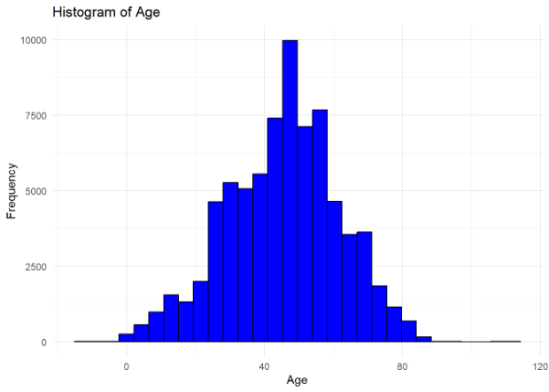
The Initial Analysis: Key Findings
Age Distribution
A large portion of bookings were from the 35–60 age group, indicating a specific target audience.

Slide 4
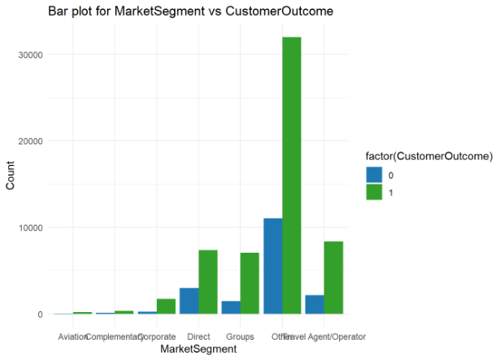
The Initial Analysis: Key Findings
Revenue Leakage
18% of bookings resulted in cancellations or no-shows, causing significant revenue leakage.

Slide 5
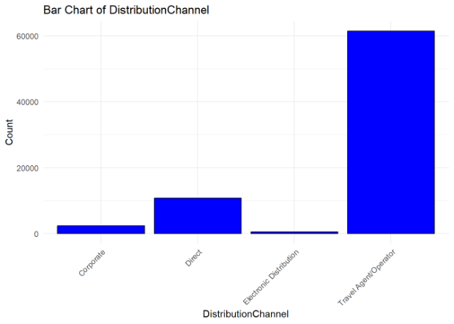
The Initial Analysis: Key Findings
Booking Channels
Most bookings were made through travel agents and direct channels, indicating the effectiveness of these channels.

Slide 6
Creating New Variables
Numerical Variables turned into Factors : BookingsCheckedIn, BookingsNoShow, BookingCanceled
CheckedInCategory : Booked but Not Checked In, Stayed Once, Stayed Twice, Stayed Thrice, Good Loyal Customers, Great Loyal Customers,
NoShowCategory : Customers Showed up and Stayed, No Show Customers
CanceledCategory : Checked In and Stayed, Canceled Bookings
We also changed the Nationality variable in Continents so that we can group them

Slide 7
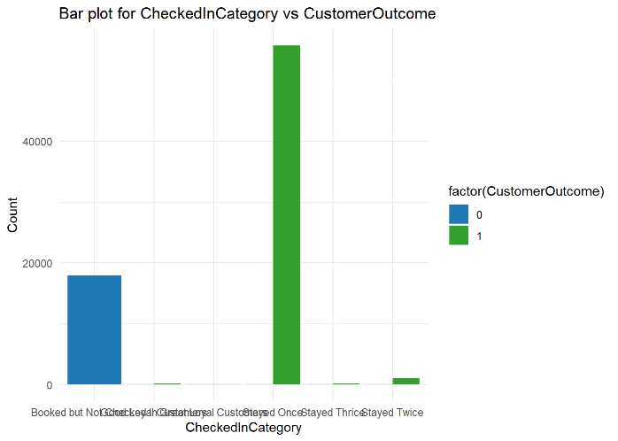
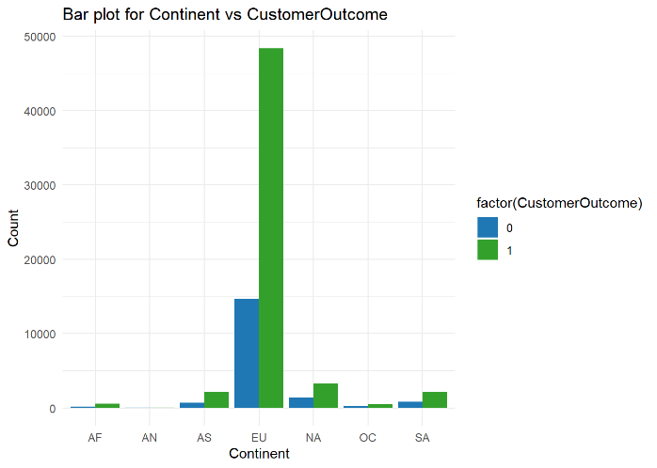

Slide 8
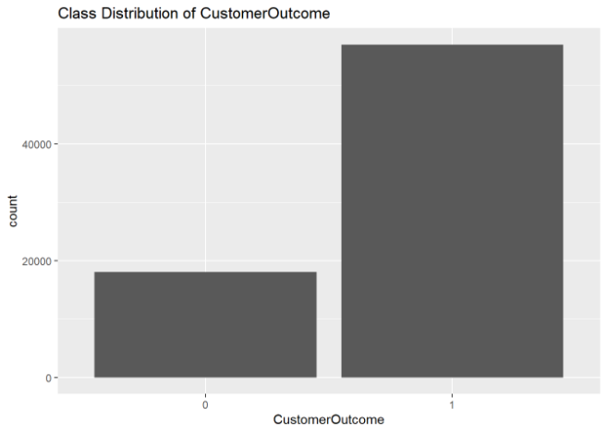
Customer Outcome (New Variable)
0 = No Show or Canceled 18020
1 = Lodged in Customers 56980 We used under-sampling to balance the data
Balanced data observations
0 = 18020
1 = 18020

Slide 9
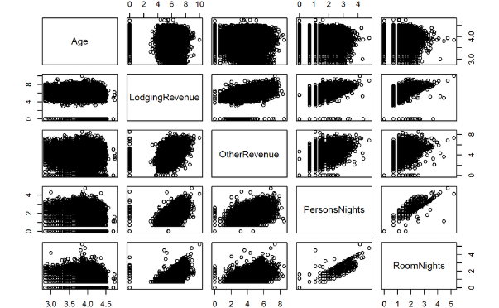
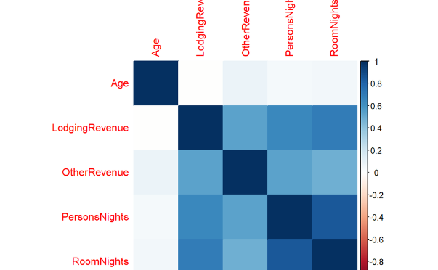
Correlation Analysis
Customer Age vs Lodging Revenue
Room Nights vs Person Nights
The correlation between Age and LodgingRevenue is very low (0.02), indicating little to no linear relationship.
There was a high correlation of 0.81 between room nights and person nights, aligning with the business context.
Age and OtherRevenue:
The correlation between Age and OtherRevenue is also low (0.08).

Slide 10

Using Logistic Regression
1
Model Development
Several models were created with different algorithms and features to address Customer no-shows and cancellations.
2
Model Evaluations
The models were evaluated based on classification accuracy, AUC-ROC curve, and specificity for robustness.
3
Evaluation Conclusions
Model 1 appears to have the best balance, while Model 3 likely suffered from overfitting.
Model 6 has high accuracy but risk of overfitting on room nights variable
Models 4 and 5 have weaker accuracy metrics

Slide 11
Key Insights from Model Evaluations
Model
Accuracy
Specificity
Key Variables & Observations
1
0.9975
0.9957
Travel agent bookings significant
2
0.7012
0.9929
Multiple revenues and nights variables significant
3
1.0000
1.0000
Perfect score indicates overfitting
4
0.5332
0.5563
SRKingSizeBed significant
5
0.7937
0.7937
Distribution channels significant
6
0.9963
0.9928
RoomNights stand out
7
0.9931
0.9931
Both room and person nights significant

Slide 12
Using Random Forest
Model
Variables
Accuracy
Confusion Matrix
Model 5
SRHighFloor, ..., DistributionChannel
55.99%
1923 TP, 5285 FP, 1059 FN, 6149 TN
Model 6
SRHighFloor, ..., RoomNights
99.63%
7208 TP, 0 FP, 53 FN, 7155 TN
Model 1
Continent, Age, ..., CheckedInCategory
99.75%
7203 TP, 5 FP, 31 FN, 7177 TN
Model 4
SRHighFloor, ..., SRQuietRoom
53.32%
3458 TP, 3750 FP, 2979 FN, 4229 TN

Slide 13
Using Naive Bayes
Model
Accuracy
Analysis
Model 5
53.69%
Slightly better
Model 6
90.11%
Significantly improved accuracy, more reliable.
Model 1
99.58%
Highest accuracy, potential overfitting.
Model 4
53.31%
Little predictive value beyond chance.

Slide 14
Enhancing the Models: Recommendations
1
Model 4:
2
Model 5:
3
Model 6:
Baseline room features for improvement
Incorporate more granular segments for greater accuracy
Combine multiple approaches and monitor against overfitting risks
4
Ensemble Approaches:
5
Rigorous Cross-Validation:
Combine the models to leverage their strengths
Ensure robustness with rigorous cross-validation procedures

Slide 15
Implementation Roadmap for Hotel Lisbon
Quick Wins (0 - 3 months)
IT systems to flag high-risk bookings
Travel agent account rep program
Long Term Initiatives (6-12 months)
Renegotiate corporate discount rates
Upgrade room allocation to loyalty members
Personalized direct booking promotions
Launch targeted retention incentives like social media ads

Slide 16
Conclusion
In conclusion, this rigorous analytical evaluation provides Hotel Lisbon the capability to reliably identify cancellation-prone reservations. Proactive and targeted interventions can positively impact guest retention and revenue optimization. Furthermore, the analytical approach can drive innovation in enhancing the overall customer experience.

